Slide 1
Lecture 8
Introduction to Weka

Slide 2
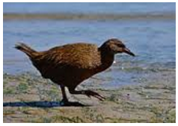
Introduction
What’s Weka?
  A bird found only in New Zealand
WEKA: Waikato Environment for Knowledge Analysis
  A collection of open source of many data mining and machine learning algorithms, including
    pre-processing on data
    classification:
    clustering
    association rule extraction
  Developed by the Department of Computer Science, University of Waikato, New Zealand
    Written in Java (distributed under the GNU Public License)
    Used for research, education, and applications

Slide 3
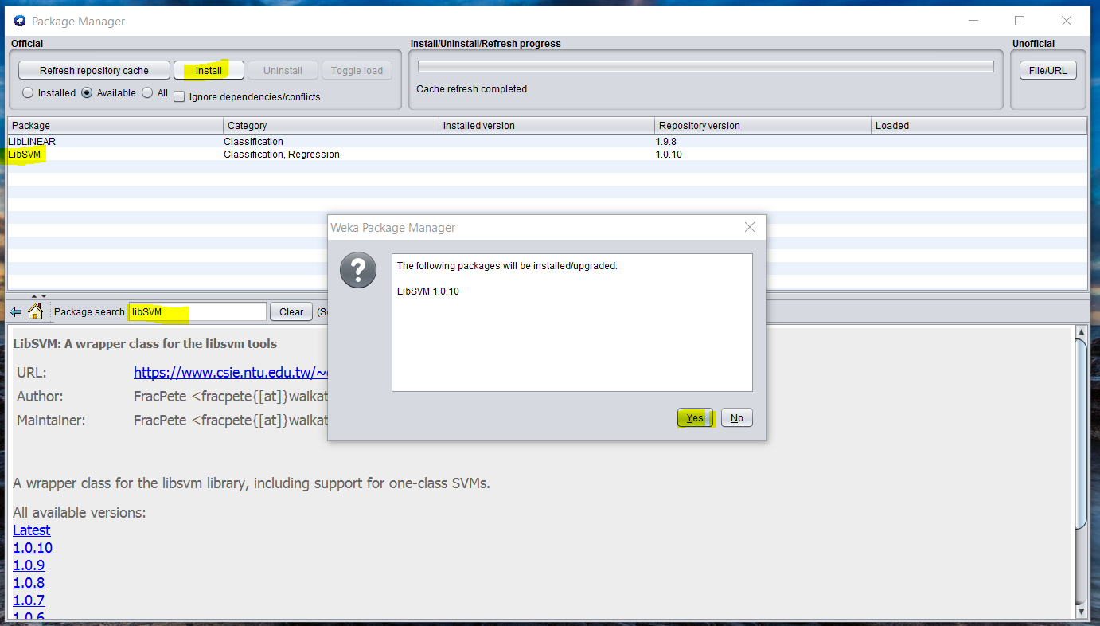
Weka Main Features
100+ algorithms for classification
75 for data preprocessing
25 to assist with feature selection
20 for clustering, finding association rules, etc
WEKA 3.8 has tool Management, easy expansion

Slide 4
Download and Install WEKA
    Download Weka 3.8.1(the latest stable version) from
    http://www.cs.waikato.ac.nz/ml/weka/downloading.html
    Choose a self-extracting executable (including Java VM)
  (If you are interested in modifying/extending weka there is a developer version that includes the source code)
  If you don't have JVM, select (weka-3-8-1jre-x64.exe; 112.0 MB) download
  If you already have JVM, select (weka-3-8-1-x64.exe; 50.6 MB) download
After download is completed, run the selfextracting file to install Weka, and use the default set-ups.

Slide 5
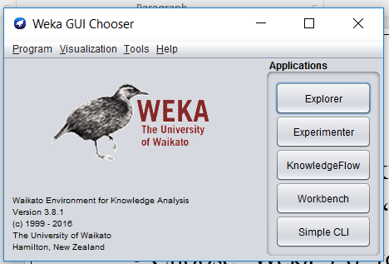
Getting Start
From windows desktop,
  click “Start”, choose “All programs”,
  Choose “Weka 3.8” to start Weka
  Then the first interface
    window appears:
    Weka GUI Chooser

Slide 6
Getting Start
Easiest way to use Weka: preprocessing, attribute selection, learning, visualization
Performance comparisons: testing and evaluating machine learning algorithms
Graphic Interface: visual design of KDD process, Explorer
supports and facilitates a range of machine learning activities reducing or removing the need for multiple tools.
Simple Command-line comparisons: A simple interface for typing commands

Slide 7
Exploring the Explorer
Click to Start a Tour!

Slide 8
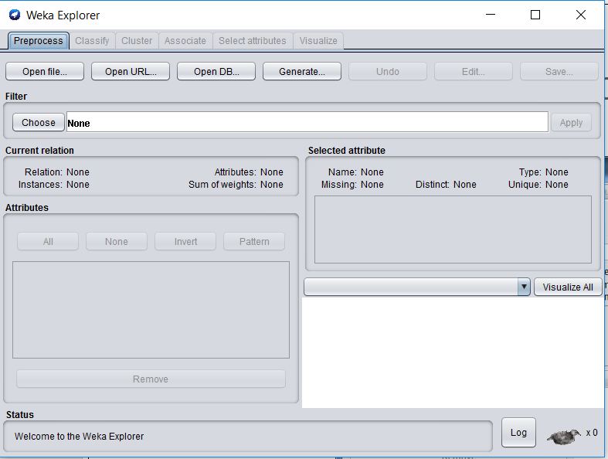
Weka Explorer Screenshot
Click to Load Data
Install Weka
Get datasets
Open Explorer
Open a dataset
Look at attributes and their values
Edit the dataset
Save it?

Slide 9
Where we find dataset
Waikato
http://www.cs.waikato.ac.nz/ml/weka/datasets.html
UCI dataset
  https://archive.ics.uci.edu/ml/datasets.html
Kaggle
  https://www.kaggle.com/

Slide 10
Load Data File and Preprocessing
Data file
  Load data file in formats: ARFF, CSV, C4.5, binary,Jason
  Import from URL or SQL database (using JDBC)
Preprocessing filters
  Adding/removing attributes
  Attribute value substitution
  Discretization
  Time series filters (delta, shift)
  Sampling, randomization
  Missing value management
  Normalization and other numeric transformations

Slide 11
Input File: The ARFF format
Require declarations of
  @relation
    declaration associates a name with the dataset
  @attribute
    declaration specifies the name and type of an attribute
  @data
    declaration is a single line denoting the start of the data segment
Detail: http://www.cs.waikato.ac.nz/~ml/weka/arff.html

Slide 12
Example of an ARFF Format File
%
% ARFF file for weather data with some numeric features
%
@relation weather
@attribute outlook {sunny, overcast, rainy}
@attribute temperature numeric
@attribute humidity numeric
@attribute windy {true, false}
@attribute play? {yes, no}
@data
sunny, 85, 85, false, no
sunny, 80, 90, true, no
overcast, 83, 86, false, yes
...
@relation declaration associates “weather” with the dataset
@attribute declaration specifies
the attribute “humidity” with the type numeric
The attribute “windy” with the type nominal
@data declaration denotes the start of the data segment

Slide 13



Attribute types
ARFF supports numeric and nominal attributes
Interpretation depends on learning scheme
  Numeric attributes are interpreted as
    ordinal scales if less-than and greater-than are used
    ratio scales if distance calculations are performed (normalization/standardization may be required)
  Instance-based schemes define distance between nominal values (0 if values are equal, 1 otherwise)
Integers: nominal, ordinal, or ratio scale?
Nominal
Ordinal
Interval/Ratio

Slide 14
Relational Attributes
Allow multi-instance problems to be represented in ARFF format
  The value of a relational attribute is a separate set of instances
  E.g.,
  Nested attribute block gives the structure of the referenced instances
@attribute bag relational
  @attribute outlook { sunny, overcast, rainy }
  @attribute temperature numeric
  @attribute humidity numeric
  @attribute windy { true, false }
@end bag

Slide 15
Additional Attribute Types
ARFF supports string attributes:
  E.g.,
  Similar to nominal attributes but list of values is not pre-specified
  It also supports date attributes:
    E.g.,
    Uses the ISO-8601 combined date and time format yyyy-MM-dd-THH:mm:ss
@attribute description string
@attribute today date

Slide 16
Multi-Instance ARFF
%
% Multiple instance ARFF file for the weather data
%
@relation weather
@attribute bag_ID { 1, 2, 3, 4, 5, 6, 7 }
@attribute bag relational
  @attribute outlook {sunny, overcast, rainy}
  @attribute temperature numeric
  @attribute humidity numeric
  @attribute windy {true, false}
@end bag
@attribute play? {yes, no}
@data
1, “sunny, 85, 85, false\nsunny, 80, 90, true”, no
2, “overcast, 83, 86, false\nrainy, 70, 96, false”, yes
...

Slide 17
Sparse Data
In some applications most attribute values in a dataset are zero
    E.g.: word counts in a text categorization problem
  ARFF supports sparse data
    E.g.,
    This also works for nominal attributes (where the first value corresponds to “zero”)
0, 26, 0, 0, 0 ,0, 63, 0, 0, 0, “class A”
0, 0, 0, 42, 0, 0, 0, 0, 0, 0, “class B”
{1 26, 6 63, 10 “class A”}
{3 42, 10 “class B”}

Slide 18
Missing values
Frequently indicated by out-of-range entries
  Types: unknown, unrecorded, irrelevant
  Reasons: malfunctioning equipment, changes in experimental design, collation of different datasets, measurement not possible
Missing value may have significance in itself (e.g. missing test in a medical examination)
  Most schemes assume that is not the case ⇒ “missing” may need to be coded as additional value
  Fill in zero/ fill in linear/ fill in first/last variable

Slide 19
Getting to know the data
Simple visualization tools are very useful for identifying problems
  Nominal attributes: histograms (Distribution consistent with background knowledge?)
  Numeric attributes: graphs (Any obvious outliers?)
2-D and 3-D visualizations show dependencies
Domain experts need to be consulted
Too much data to inspect? Take a sample!

Slide 20
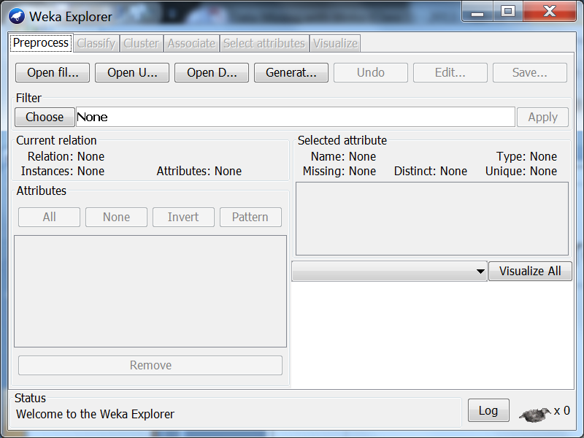
Loading the Data
open file
weather.nominal.arff

Slide 21
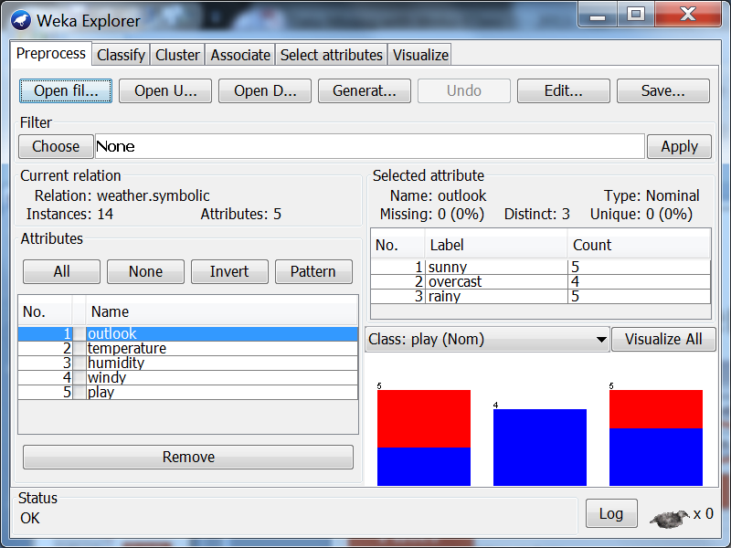
Screenshot of Loading Data

Slide 22
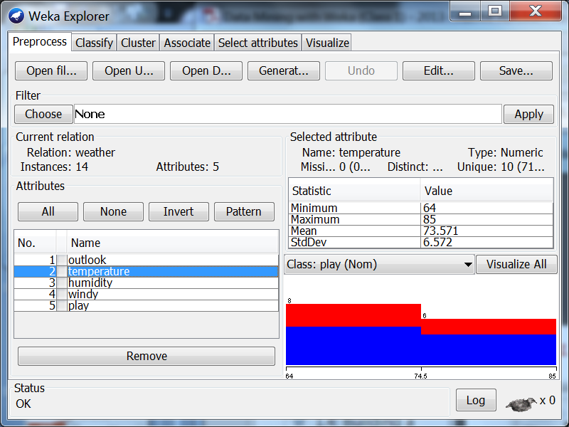
Screenshot of Loading Data
open file
weather.numeric.arff

Slide 23
Building a Decision Tree
Click to start

Slide 24
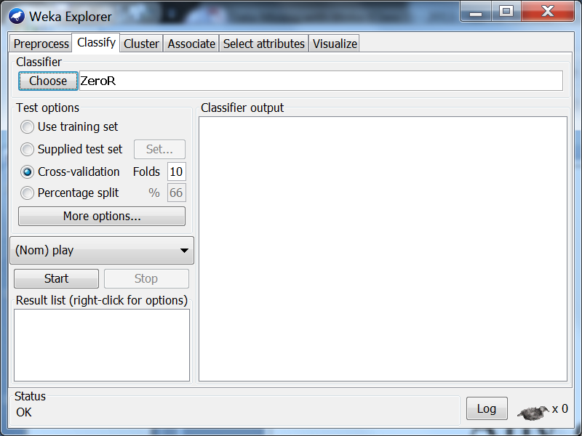
Building a Decision Tree (II)
Choose algorithm

Slide 25
Building a Decision Tree (II)
Zero is the simplest rule classifier
J48 is a simplest decision tree

Slide 26
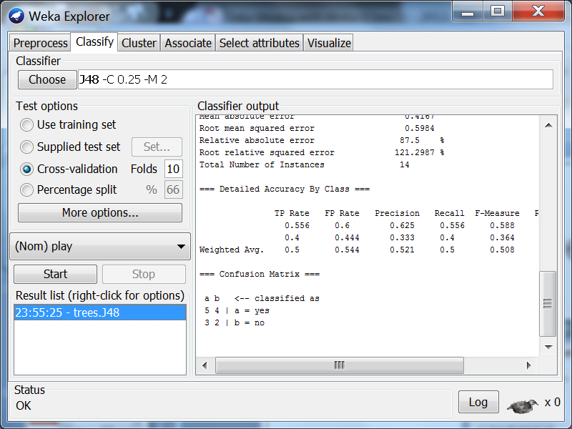
Visualizing the Results
Right-click to visualize results

Slide 27
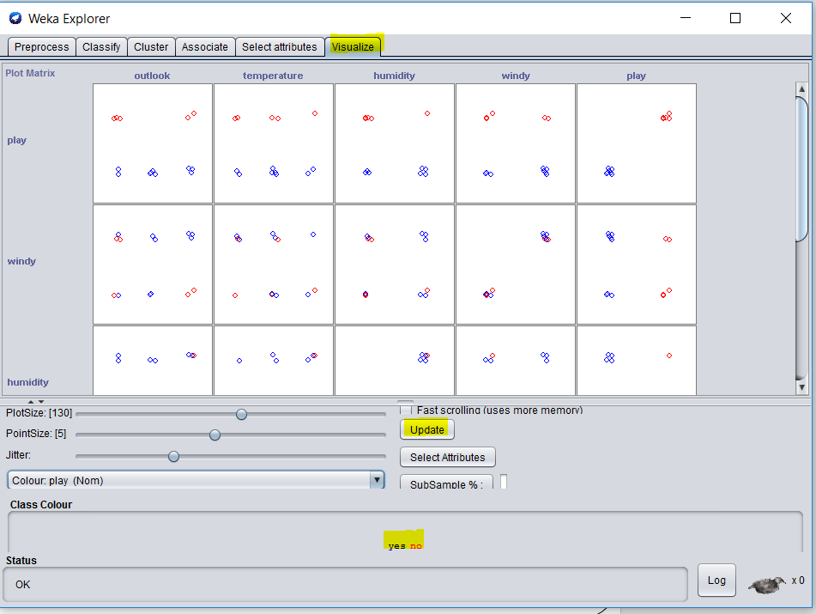
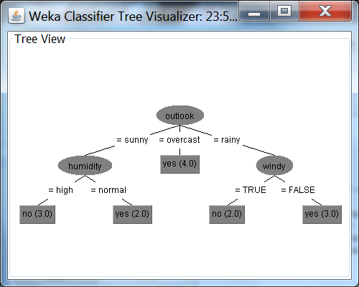
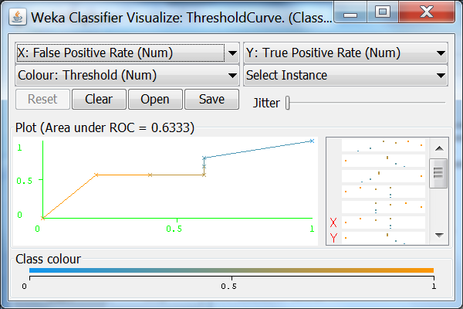
Visualizing the Results
Classifier errors
Decision tree
Threshold Curve

